Slide 1
Aakash Goel https://www.linkedin.com/in/goelaakash123/
Session 5:
Edge Detection (Canny) and Line Detection (Hough)
Acknowledgement: Slide Materials adopted from - Intro to Computer Vision (Cornell Tech); Noah Snavely, prepared by the lead instructor Prof S P Vimal , modified (added some content) by Aakash Goel

Slide 2
Topics
Edge Models & Approaches to edge detection
Canny Edge Detection
Line detection
Hough Transform
Acknowledgement: Slide Materials adopted from - Intro to Computer Vision (Cornell Tech); Noah Snavely and Shree K Nayar

Slide 3
Edge Detection
Edges are pixels where intensity (brightness) changes abruptly
Imagine a black-and-white image. An edge is like a border between black and white regions.
In real images, this means there's a sudden jump in pixel brightness—from dark to light or light to dark.
Example: edge of a table, corner of a book, outline of a person.

Slide 4
Edge Detection
Gradient’s (along x and y direction) are used to describe the direction of the largest growth of the image function
Gradient = how quickly brightness changes.
Think of it like walking on a hill: the gradient points in the direction of steepest slope.
In images:
Gx is the rate of brightness change left-to-right (horizontal edges),
Gy is the change top-to-bottom (vertical edges).
Combining them gives both edge strength and edge direction.

Slide 5
Edge Detection
Derivatives are approximated by differences
We don’t take real derivatives on a digital image.
We use simple differences between neighboring pixel values:
Example: Gx ≈ I(x+1, y) - I(x-1, y)
Just subtract brightness values between adjacent pixels.
These are used in edge detectors like Sobel, Prewitt, etc.

Slide 6
Objectives of Edge Detection
Good Detection. Filter responds to edge, not noise
The detector should only respond to actual edges, not to small intensity fluctuations or noise.
For example, in a blurry or noisy image, we still want to detect real boundaries, not random noise.
That’s why smoothing (like Gaussian blur) is often done before edge detection.
Good Localization: detected edge near true edge.
Single Response: only one point for each true edge point

Slide 7
Objectives of Edge Detection
Good Localization: detected edge near true edge.
The edge position should be as close as possible to the real edge in the image.
If an edge is at column 5, we shouldn’t mark it at column 3 or 7.
Poor localization results in inaccurate object boundaries.
Single Response: only one point for each true edge point
For one real edge, the filter should give only one response, not multiple.
This helps simplify object boundaries and shape extraction.
Multiple responses lead to thick or fragmented edges, making further processing harder.

Slide 8
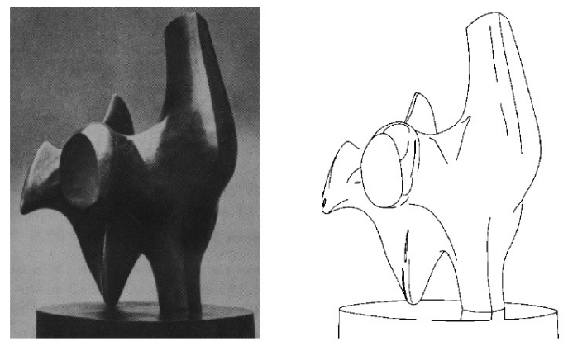
Edge Detection
Task : Convert a 2D image into a set of curves (made of edges)
Notes:
example from Vic Nalwa's book. On the left is a photograph of a sculpture by Henry Moore, and on the right is an artist’s sketch of the sculpture. With just a few strokes, the artist is able to convey essential information about the sculpture — its three-dimensional structure, its shading, its highlights, and so on. From this example, we can see that edges, even when sparse in an image, are capable of conveying vital visual information.

Slide 9
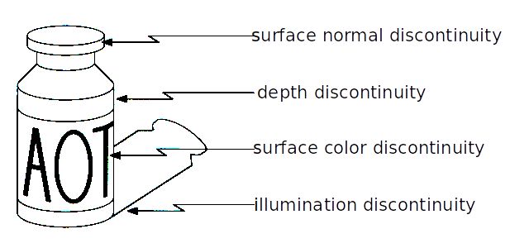
Edge Detection – Variety of factors
1. Surface Normal Discontinuity
What it means: A sudden change in the orientation of a surface in 3D space.
Analogy: Imagine folding a paper. Both parts are the same color, but the angle between them creates a visible edge due to different reflections of light.
Visual Effect: Light reflects differently → intensity changes.
Example: The corner edge of a cube or a bend in a road.
Why it causes an edge: Even if the surface has the same color, light hits differently on each face due to angle → gradient in brightness.

Slide 10
Edge Detection – Variety of factors
2. Depth Discontinuity
What it means: A sudden change in distance from the camera.
Analogy: A person standing in front of a wall — their body is closer than the wall behind.
Visual Effect: Sharp silhouette or boundary line.
Example: Edge of a tree in front of a sky background.
Why it causes an edge: The foreground object stops abruptly, revealing a different depth layer behind.

Slide 11
Edge Detection – Variety of factors
3. Surface Color (Reflectance) Discontinuity
What it means: A change in the inherent color or reflectance of the surface itself.
Analogy: A white sticker placed on a red notebook.
Visual Effect: Sudden color change, not caused by lighting or angle.
Example: Zebra stripes, red apple with green sticker.
Why it causes an edge: Pixel intensity (or color) jumps suddenly because the material itself changes.

Slide 12
Edge Detection – Variety of factors
4. Illumination Discontinuity
What it means: A change in lighting — either sudden (shadow) or gradual (spotlight).
Analogy: A bright torchlight illuminating part of a wall in a dark room.
Visual Effect: Part of the image is bright, part is dark — even if surface color is same.
Example: Shadow of a tree on a sidewalk.
Why it causes an edge: Change in light causes a change in brightness, but not due to object or material change.

Slide 13
Recall: Edge Detector (Edge Operator Output)
a. Edge Position
What it is: The exact location in the image where the edge occurs.
Why it matters: To accurately find object boundaries.
Example: Finding the boundary between a person and the background in a photo.
b. Edge Magnitude (Strength)
What it is: How strong the edge is — how big the change in brightness or color is.
Why it matters: Stronger edges usually indicate more important features.
Example: Edge between black and white = strong; edge between two shades of gray = weak.
c. Edge Orientation (Direction)
What it is: The angle or direction the edge is pointing.
Why it matters: Helps in shape analysis and detecting specific patterns.
Example: A vertical edge (↕️) has different meaning than a horizontal edge (↔️).

Slide 14
Recall: Edge Detector (Performance Requirements)
Requirement | What It Means | Analogy or Visualization
High Detection Rate | Finds all real edges in the image | Like detecting all road boundaries in a self-driving car camera
Good Localization | Places the edge exactly where it actually is | Don’t just say “there’s a door nearby”—pinpoint the actual edge of the door
Low Noise Sensitivity | Avoid detecting random patterns or noisy textures as edges | Like ignoring shadows or camera grain while detecting real objects
A good edge detector is not just about finding differences, but about finding the right differences, at the right place, in the right direction, and ignoring distractions.

Slide 15
Canny – Edge Detection
Canny is considered the gold standard of edge detection. It improves over basic gradient methods by:
Reducing noise
Avoiding false edges
Ensuring clean and connected edges
🧠 Intuition: Think Like a Detective
Imagine trying to find the boundaries of objects in a photo while avoiding distractions like shadows, noise, and soft textures. Canny is like a detective with 5 steps of evidence collection.

Slide 16
Steps :: Canny – Edge Detection
Step | Name | Goal | Analogy
1 | Noise Reduction | Smooth the image | Clean your glasses before looking
2 | Gradient Computation | Detect edge strength & direction | Like Sobel—find where the image changes
3 | Non-Maximum Suppression | Thin the edges | Keep only the sharpest edge in a local area
4 | Double Thresholding | Separate strong vs weak edges | Think of bold vs faint pencil lines
5 | Edge Tracking by Hysteresis | Keep only connected, meaningful edges | Weak edges near strong ones are kept; others are discarded
https://www.cse.iitd.ac.in/~pkalra/col783-2017/canny.pdf
https://automaticaddison.com/how-the-canny-edge-detector-works/
https://medium.com/data-science/canny-edge-detection-step-by-step-in-python-computer-vision-b49c3a2d8123 -- Explain NMS

Slide 17
Steps in Canny's Edge Detection
1. Smooth the input image with a Gaussian ﬁlter.
2. Compute the gradient magnitude and angle images.
3. Apply non-maxima suppression to the gradient magnitude image.
4. Use double thresholding and connectivity analysis to detect and link edges.

Slide 18
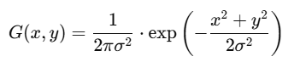
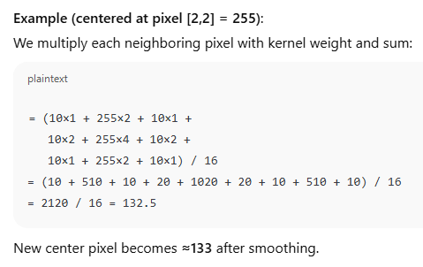
Canny Edge Detection - Breakdown
5×5 grayscale image -- This simulates a vertical white edge in the middle of an otherwise dark image.
[ [10, 10, 10, 10, 10],
[10, 10, 255, 10, 10],
[10, 10, 255, 10, 10],
[10, 10, 255, 10, 10],
[10, 10, 10, 10, 10] ]
Apply a Gaussian filter to reduce noise.
3×3 Gaussian Kernel (σ ≈ 1):
[ [1, 2, 1],
[2, 4, 2],
[1, 2, 1] ] / 16

Slide 19
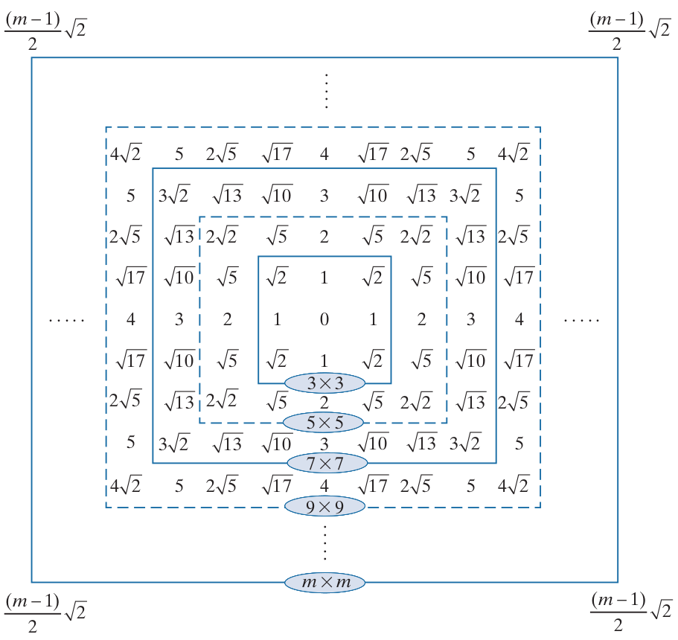
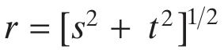
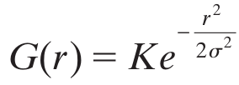
Recall: Gaussian Filters
Let s and r be position of a cell in a filter w.r.t the origin; r represent the distance of the cell from the center
Form of Gaussian kernels is as below:
Distances from the center for various sizes of square kernels.

Slide 20
Math – Gaussian Kernel
cv2.GaussianBlur(img, (5, 5), 1.4)
img: Input image.
(5, 5): Size of the Gaussian kernel (height × width).
1.4: Standard deviation (σ) of the Gaussian distribution.
Sigma controls how much the image is blurred.
A higher sigma → more spread in the Gaussian → more smoothing (heavier blur).
A lower sigma → tighter Gaussian → less smoothing (sharper result).
In image terms:
σ = 0.5: Barely blurs.
σ = 1.4: Good default in Canny edge detection.
σ = 3+: Very blurry — can suppress finer details and edges.

Slide 21
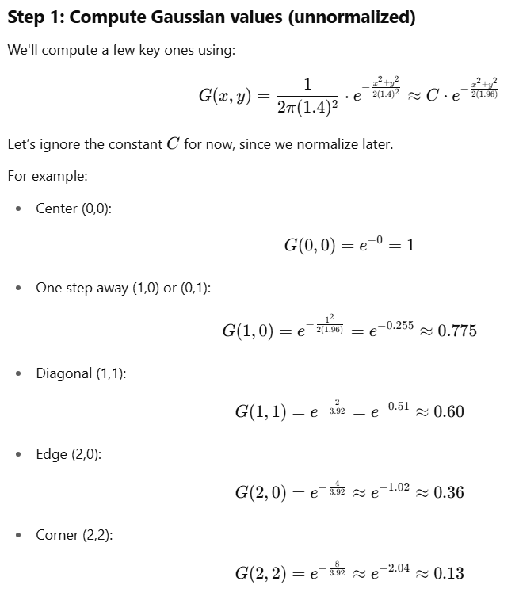
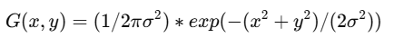
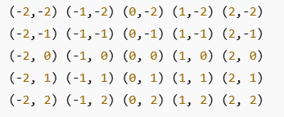
Math – Gaussian Kernel
Kernel Grid (x,y) co-ordinates

Slide 22
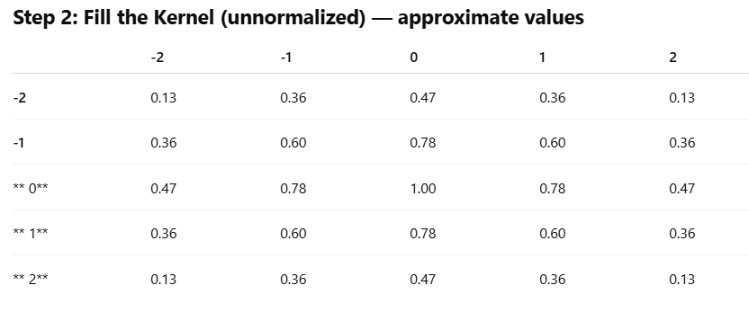
Math – Gaussian Kernel

Slide 23
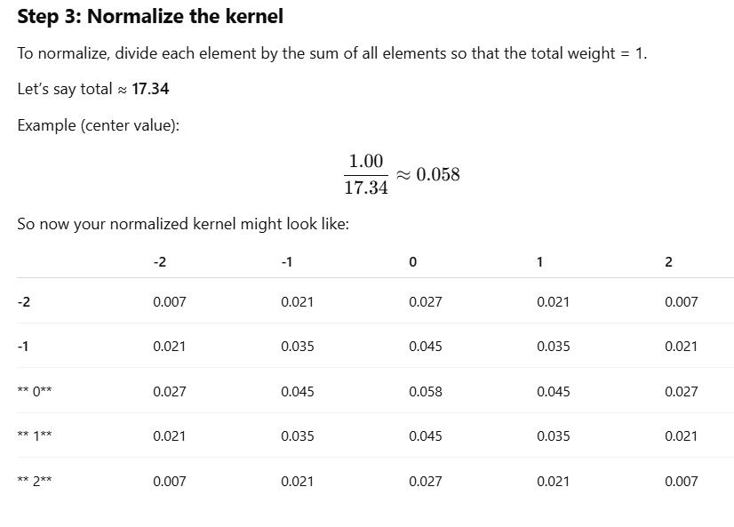
Math – Gaussian Kernel
σ = 1.4 makes the center pixel most influential (weight ≈ 0.058), but neighboring pixels also contribute, though less.
Farther pixels get exponentially smaller weights.
If σ is larger → weights are more evenly spread (blurry image).
If σ is smaller → weights are more concentrated near the center (less blur).

Slide 24
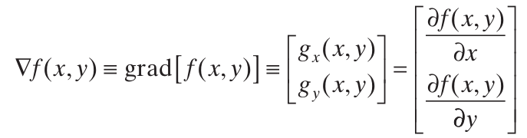
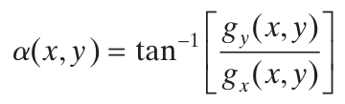
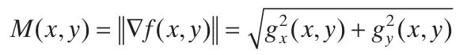
Step -2: Computing Gradients (Magnitude and Direction)
Compute partial derivatives ∂f/∂x and ∂f/∂y at every pixel location in the image
Points in the direction of maximum rate of change of f at ( x, y)
Direction of gradient vector at ( x, y)
Value of the rate of change in the direction of the gradient vector at ( x, y)

Slide 25
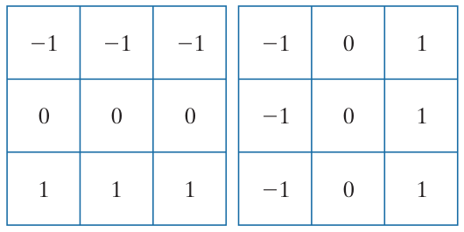
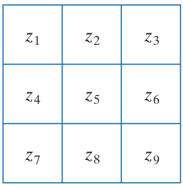
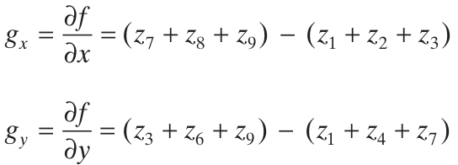
Step -2: Computing Gradients (Magnitude and Direction)
Prewitt’s operators
A 3 × 3 region of an image (the z’s are intensity values)
To Do: Compute
gradient at z₅

Slide 26
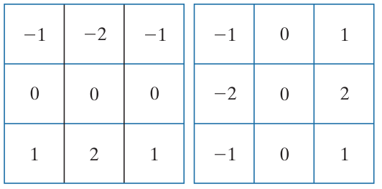
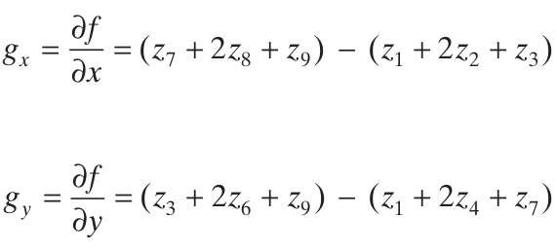
Step -2: Computing Gradients (Magnitude and Direction)
Sobel’s operators
A 3 × 3 region of an image (the z’s are intensity values)
To Do: Compute
gradient at z₅

Slide 27
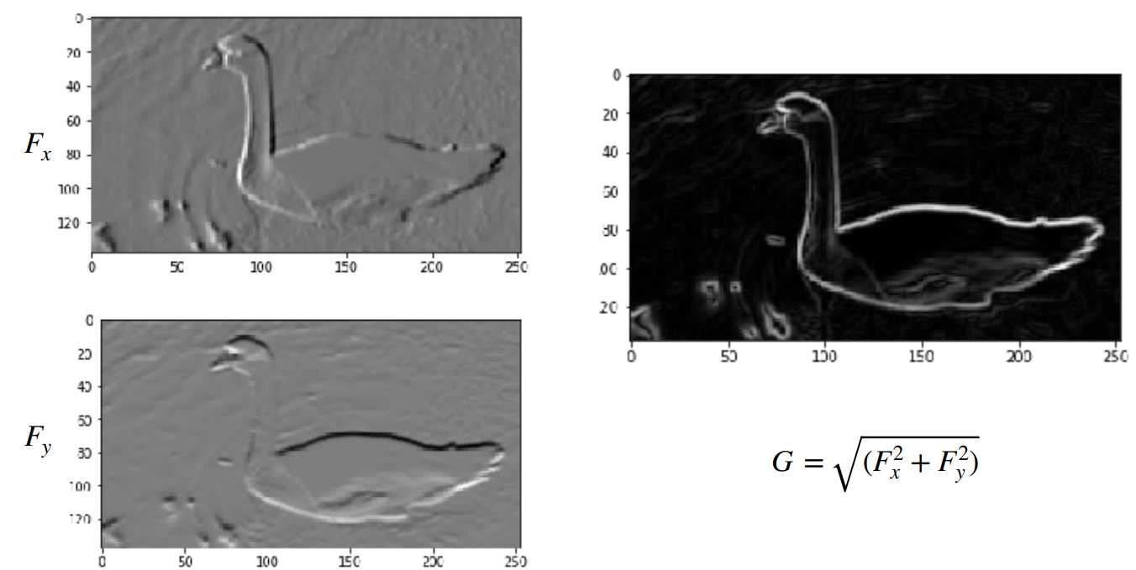
Step -2: Computing Gradients (Magnitude and Direction)

Slide 28
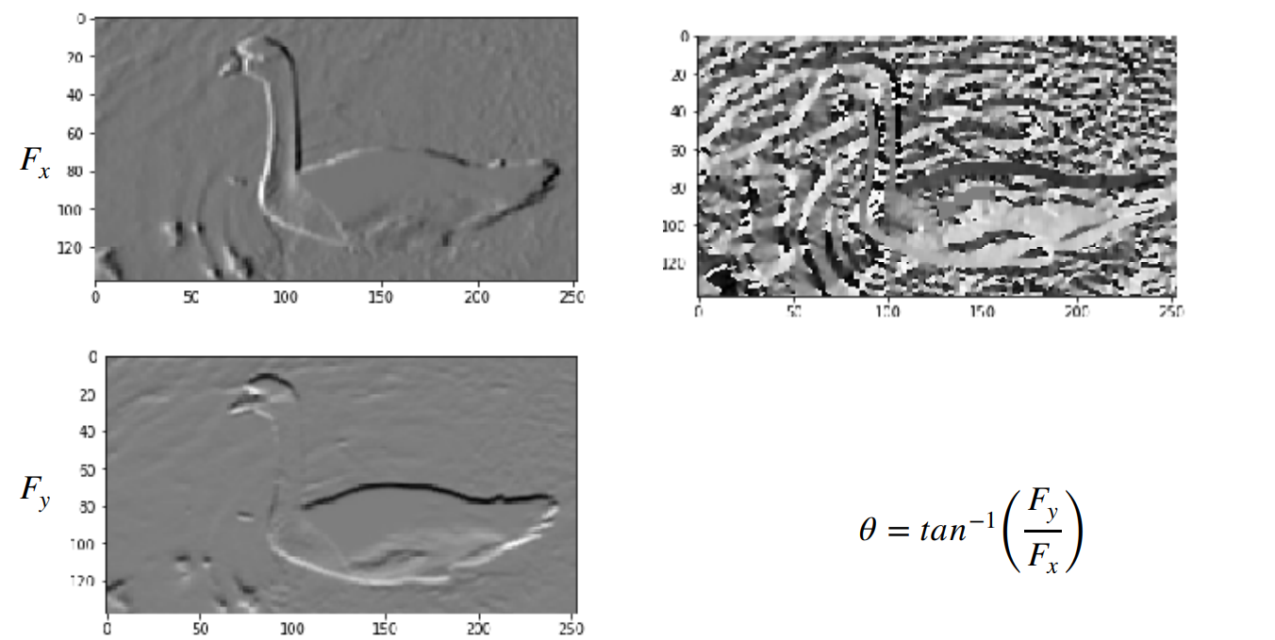
Step -2: Computing Gradients (Magnitude and Direction)

Slide 29
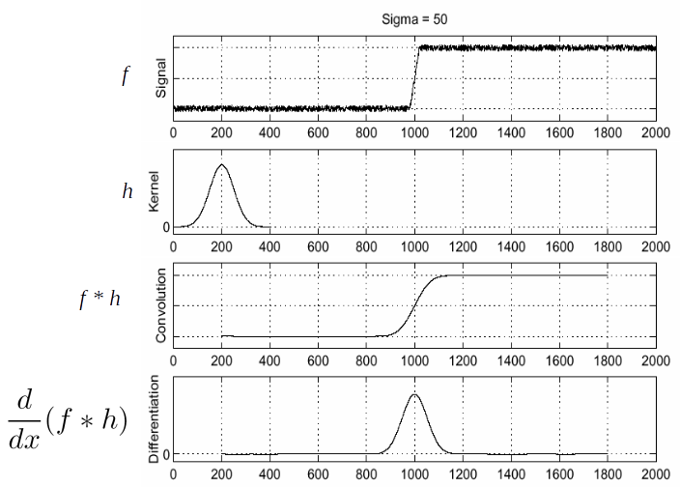
(Aside) Step -2: Efficient Computation of Image Gradients

Slide 30
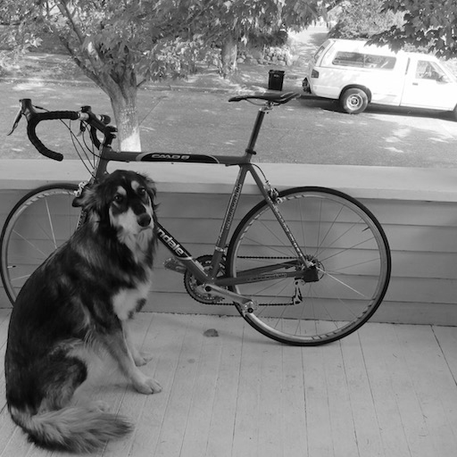
Ex: Step -1 and Step-2
Original Image

Slide 31
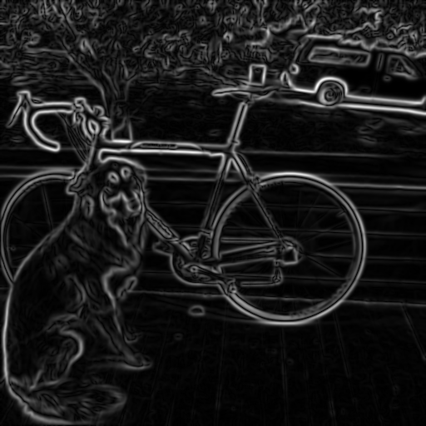
Ex: Step -1 and Step-2
Smoothed Gradient Magnitude
Original Image

Slide 32

Ex: Step -1 and Step-2
Where is the edge?
Smoothed Gradient Magnitude

Slide 33
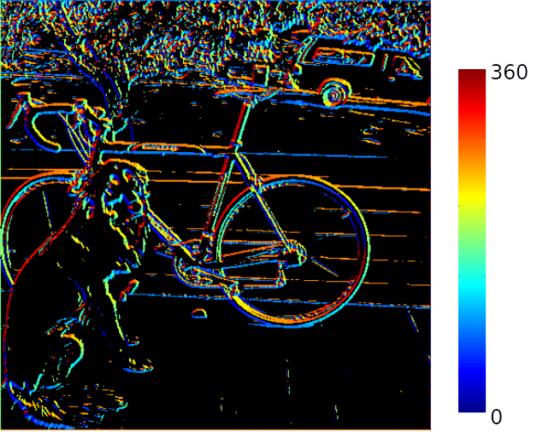
Ex: Step -1 and Step-2
Smoothed Gradient Magnitude
Can we make use of angle to locate the edge better?

Slide 34
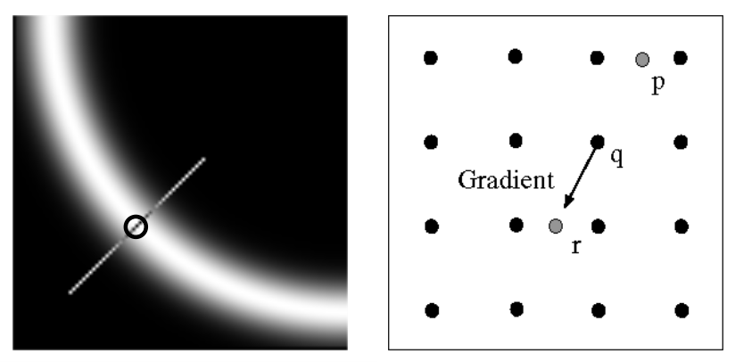
Step -3: Non-Maxima Suppression
Check if pixel is local maximum along gradient direction

Slide 35
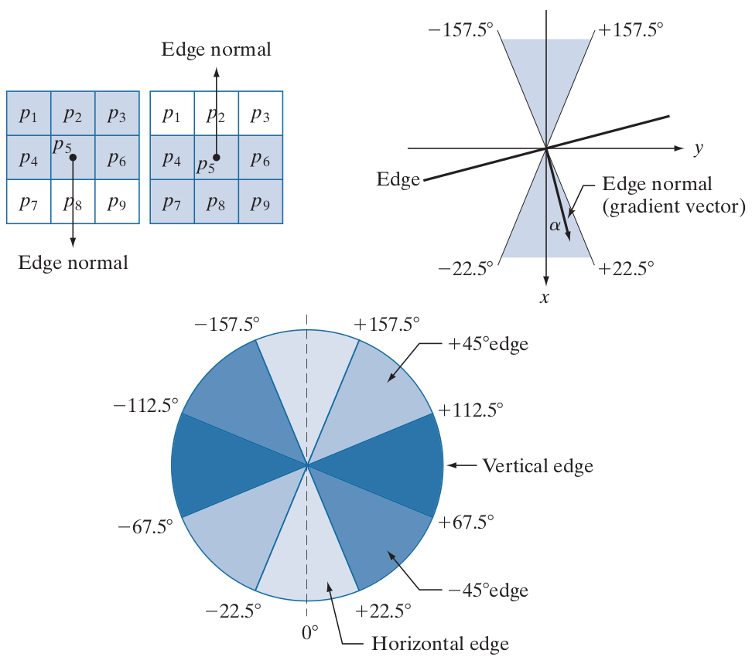
Step -3: Non-Maxima Suppression - Computation
Let d₁, d₂,d₃ and d₄ refers to horizontal, vertical, +45º and -45º edges.

Slide 36
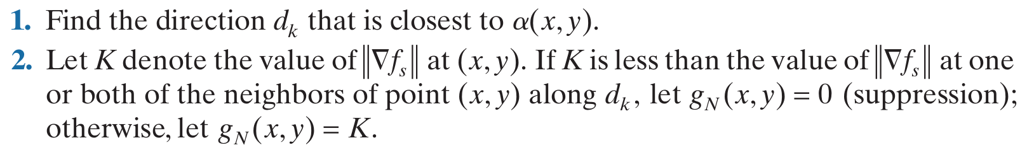
Step -3: Non-Maxima Suppression - Computation
Let 𝜶 be the matrix if gradient orientations
Let d₁, d₂,d₃ and d₄ refers to horizontal, vertical, +45º and -45º edges.
Consider a 3x3 neighborhood around 𝜶(x,y)
Non-Maxima Scheme around 𝜶(x,y) is as below:
Repeat (1) and (2) for all values of x and y to get non-maxima suppressed image which is of the same size as original image.

Slide 37
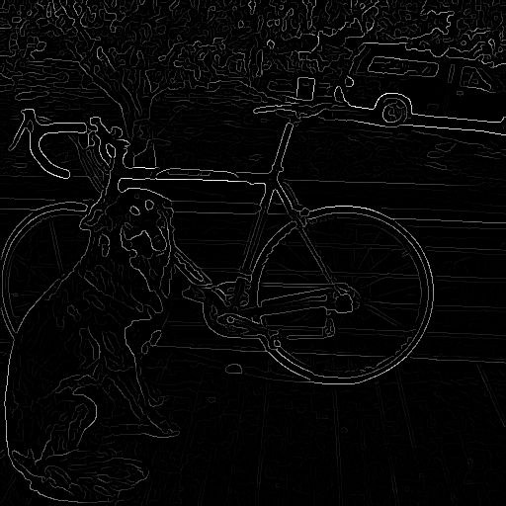
Step -3: Non-Maxima Suppression - Computation
Before Non-Maxima Suppression
After Non-Maxima Suppression

Slide 38
Step -4: Double Thresholding and Edge Linking
Still some noise; Only need strong edges;
Called as Hysteresis thresholding
Use two thresholds T_{L} and T_{H} which results in two images;
Choose the ratio of high to low threshold in the range of 2:1 to 3:1.

Slide 39
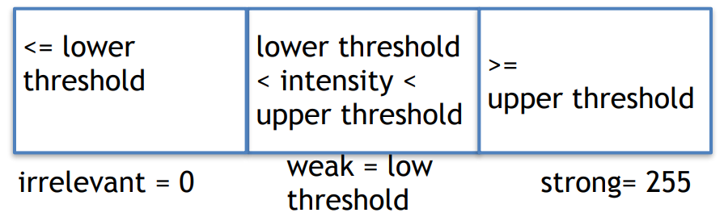
Step -4: Double Thresholding and Edge Linking

Slide 40


Step -4: Double Thresholding and Edge Linking

Slide 41
Step -4: Double Thresholding and Edge Linking
Strong Edge Pixels & Valid Edge Pixels
Weak Edge Pixels & we need to identify valid edge pixels from this set.

Slide 42
Step -4: Double Thresholding and Edge Linking
Strong Edge Pixels & Valid Edge Pixels
Weak Edge Pixels & we need to identify valid edge pixels from this set.

Slide 43
Step -4: Double Thresholding and Edge Linking
Approach to Link Edges:
Strong edges are edges!
Weak edges are edges iff they connect to strong
Look in some neighborhood (usually 8 closest)

Slide 44
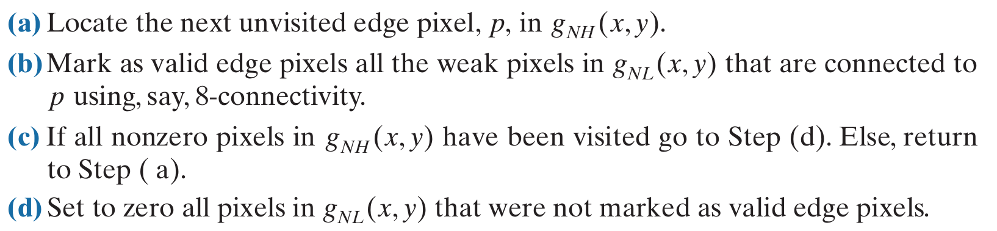
Step -4: Double Thresholding and Edge Linking

Slide 45
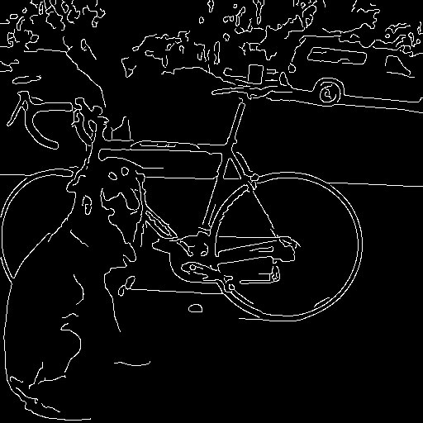
Step -4: Double Thresholding and Edge Linking
Before Edge Linking
After Edge Linking

Slide 46
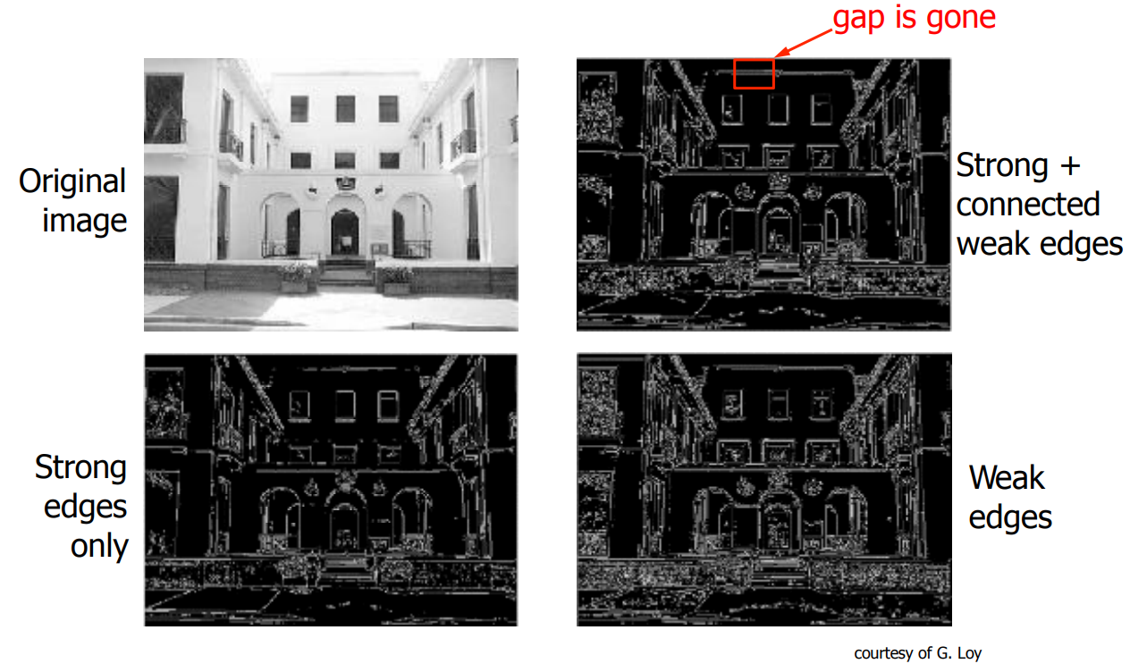
Step -4: Double Thresholding and Edge Linking

Slide 47
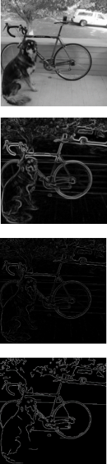
Summary of Canny Edge Detector
Filter image with derivative of Gaussian
(2) Find magnitude and orientation of gradient
(3) Non-maximum suppression
(4) Linking and thresholding (hysteresis):
Define two thresholds: low and high
Use the high threshold to start edge curves and the low threshold to continue them

Slide 48
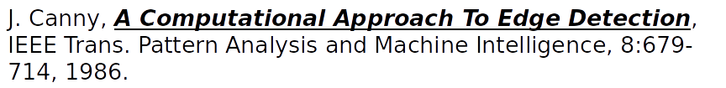
Summary of Canny Edge Detector
Our first computer vision pipeline!
Still a widely used edge detector in computer vision

Slide 49
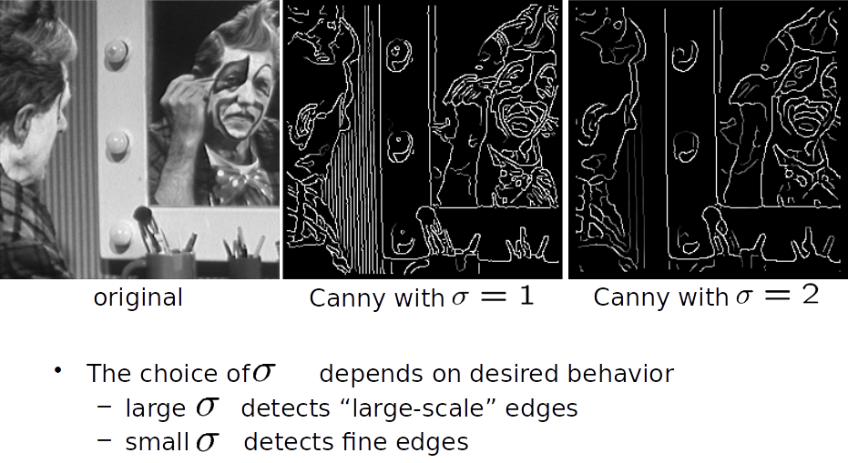
Summary of Canny Edge Detector

Slide 50
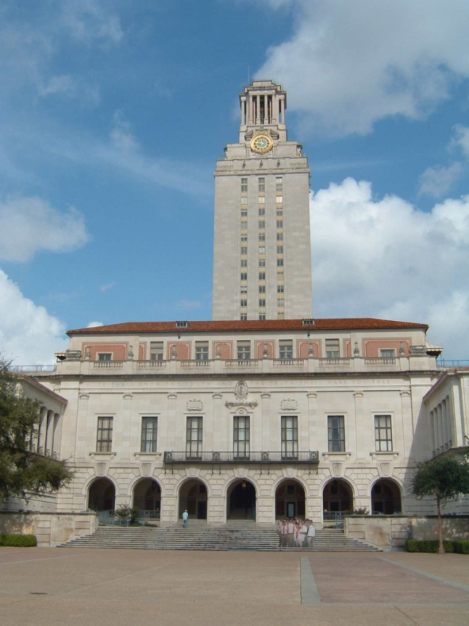
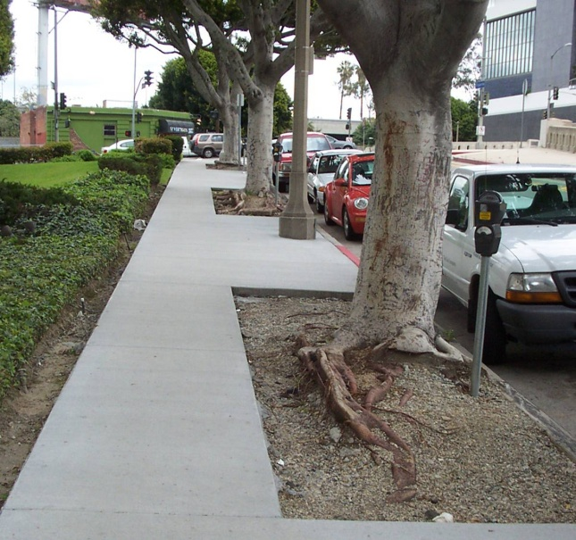
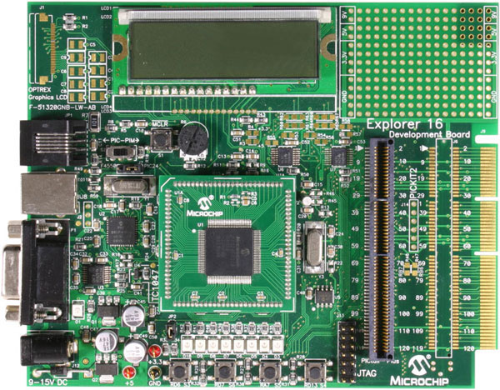
Line Fitting
Many objects characterized by presence of straight lines
Wait, why aren’t we done just by running edge detection?

Slide 51
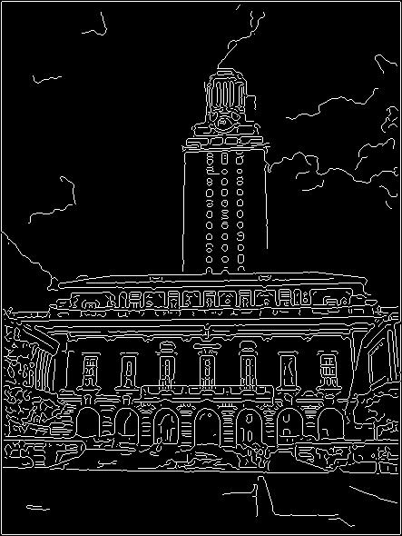
Difficulty in Line Fitting
Extra edge points (clutter), multiple models:
which points go with which line, if any?
Only some parts of each line detected, and some parts are missing:
how to find a line that bridges missing evidence?
Noise in measured edge points, orientations:
how to detect true underlying parameters?
Kristen Grauman

Slide 52
Role of Voting in Line Fitting
It’s not feasible to check all combinations of features by fitting a model to each possible subset.
Voting is a general technique where we let the features vote for all models that are compatible with it.
Cycle through features, cast votes for model parameters.
Look for model parameters that receive a lot of votes.
Noise & clutter features will cast votes too, but typically their votes should be inconsistent with the majority of “good” features.
Kristen Grauman

Slide 53
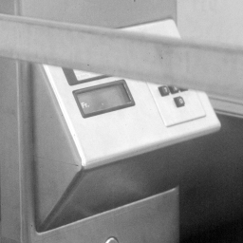

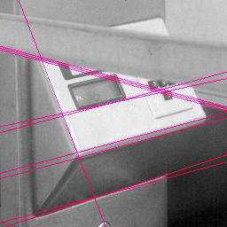
Hough Transform for Line Fitting
Given points that belong to a line, what is the line?
How many lines are there?
Which points belong to which lines?
Hough Transform is a voting technique that can be used to answer all of these questions.
Main idea:
1. Record vote for each possible line on which each edge point lies.
2. Look for lines that get many votes.
Kristen Grauman

Slide 54

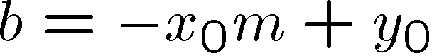
Hough Transform for Line Fitting
Equation of a line?
y = mx + b
y
b
b₀
x
m₀
m
image space
Hough (parameter) space
Connection between image (x,y) and Hough (m,b) spaces
A line in the image corresponds to a point in Hough space
To go from image space to Hough space:
given a set of points (x,y), find all (m,b) such that y = mx + b
What does a point (x₀, y₀) in the image space map to?
Answer: the solutions of b = -x₀m + y₀
this is a line in Hough space
Kristen Grauman

Slide 55
Hough Transform for Line Fitting
Equation of a line?
y = mx + b
y
b
y₀
x₀
x
m
image space
Hough (parameter) space
What are the line parameters for the line that contains both (x₀, y₀) and (x₁, y₁)?
It is the intersection of the lines b = –x₀m + y₀ and b = –x₁m + y₁
Kristen Grauman

Slide 56
Hough Transform for Line Fitting
Equation of a line?
y = mx + b
y
b
x
m
image space
Hough (parameter) space
How can we use this to find the most likely parameters (m,b) for the most prominent line in the image space?
Let each edge point in image space vote for a set of possible parameters in Hough space
Accumulate votes in discrete set of bins; parameters with the most votes indicate line in image space.
Kristen Grauman

Slide 57
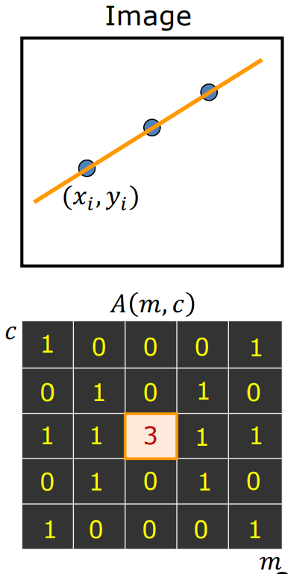
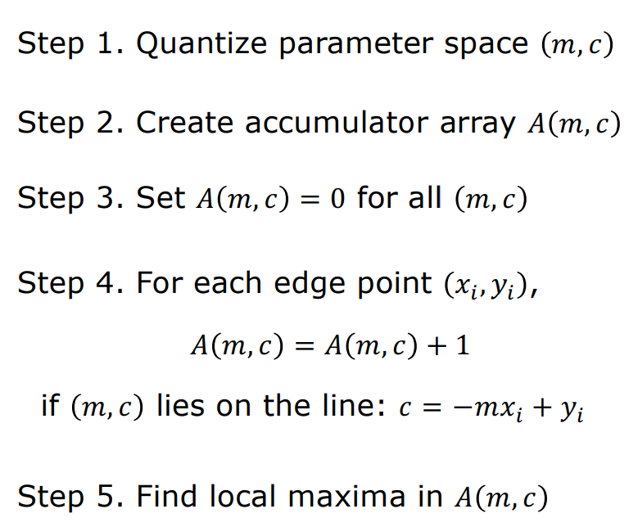
Hough Transform for Line Fitting
Shree K. Nayar

Slide 58
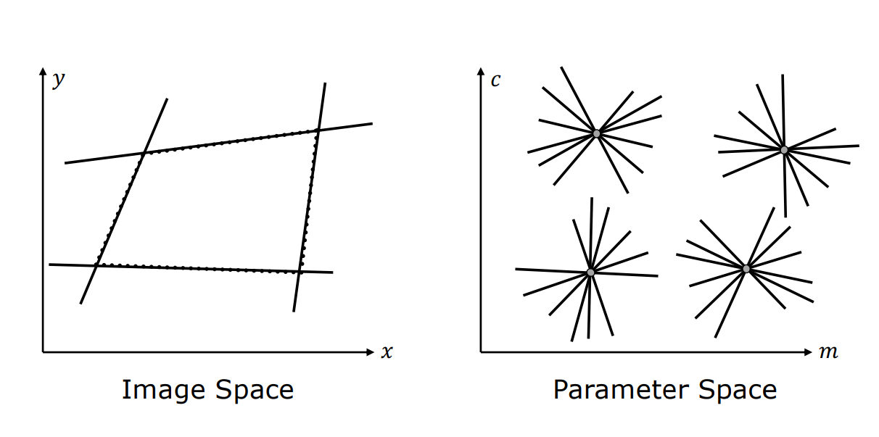
Hough Transform for Line Fitting
Shree K. Nayar

Slide 59
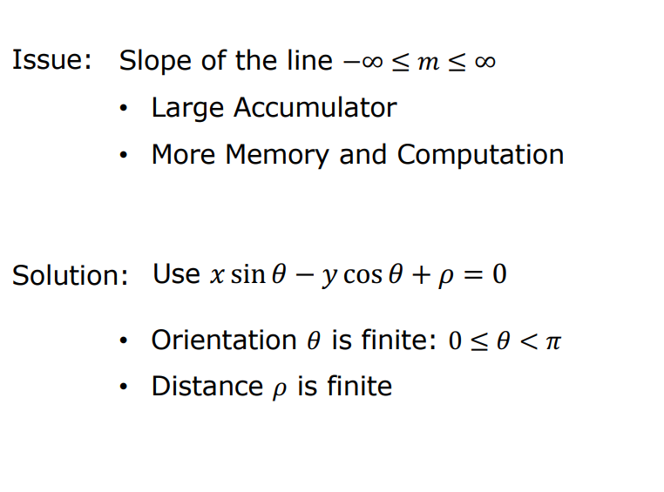
Hough Transform for Line Fitting
Shree K. Nayar

Slide 60


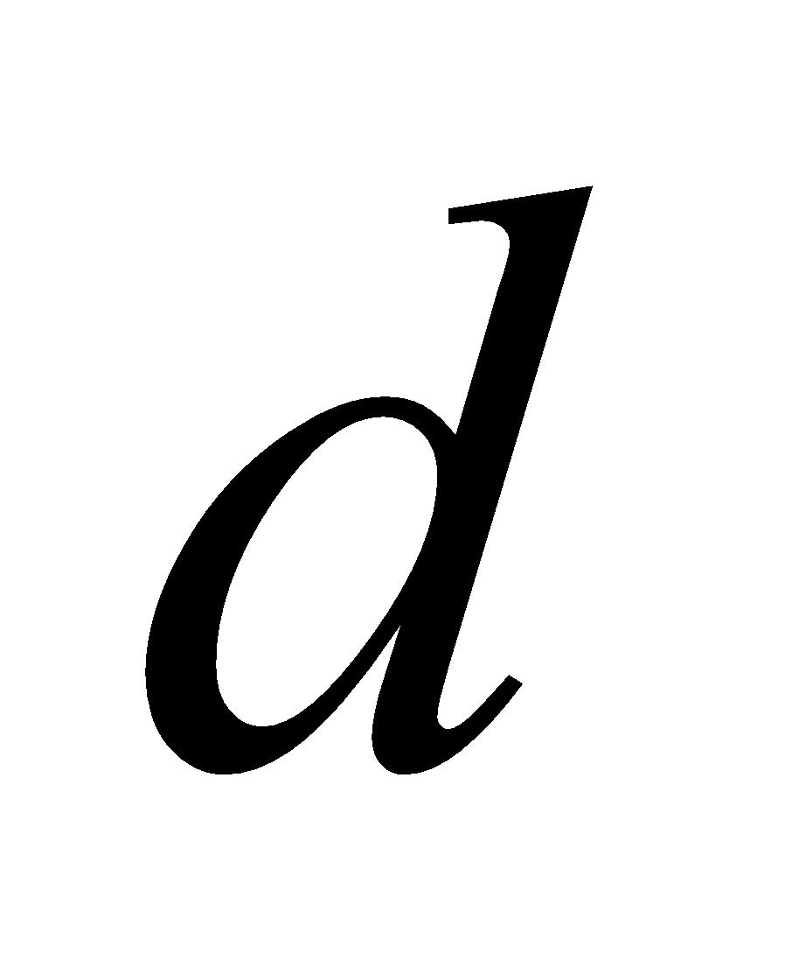

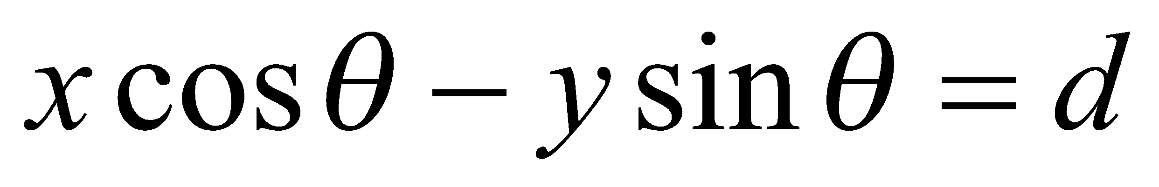
Polar Representation of Lines
Image columns
[0,0]
: perpendicular distance from line to origin
: angle the perpendicular makes with the x-axis
Image rows
Shree K. Nayar

Slide 61

Alternate formulation using Polar Representation of Lines
ⲣ : perpendicular distance from line to origin
Θ : angle the perpendicular makes with the x-axis
Shree K. Nayar

Slide 62

Alternate formulation using Polar Representation of Lines
Shree K. Nayar

Slide 63




Examples - Hough Transform
Kristen Grauman

Slide 64

Numericals
Determine if (1,2), (2,3) and (3,4) are in the same line using Hough transformation
y=mx+c ⇒ c = -mx+y
(x, y) ==(1,2)
(m, c) == ?
c= -m+2
for m = 0 , c = 2
m=1, c=
m=2 c=0
(2,3) ===
c=-2m+3
m=0 , c = 3
m=1.5, c= 0
3, 4 —-
c =-3m+4
m=0, c = 4
m = 4/3 c =0
c
m

Slide 65
Given Points:
Point 1: (1,2)(1, 2)(1,2)
Point 2: (2,3)(2, 3)(2,3)
Point 3: (3,4)(3, 4)(3,4)
Equation of Line:
The equation of a line is y=mx+cy = mx + cy=mx+c, where mmm is the slope and ccc is the y-intercept.
Step 1: Derive c from each point
For (1,2)(1, 2)(1,2): c=2−mc = 2 - mc=2−m
For (2,3)(2, 3)(2,3): c=3−2mc = 3 - 2mc=3−2m
For (3,4)(3, 4)(3,4): c=4−3mc = 4 - 3mc=4−3m
Step 2: Solve System of Equations
c=2−mc = 2 - mc=2−m
c=3−2mc = 3 - 2mc=3−2m
Set the equations equal:
2−m=3−2m⇒m=12 - m = 3 - 2m \quad \Rightarrow \quad m = 12−m=3−2m⇒m=1
Substitute m=1m = 1m=1 into c=2−mc = 2 - mc=2−m:
c=2−1=1c = 2 - 1 = 1c=2−1=1
Step 3: Line Equation
The line equation is:
y=x+1y = x + 1y=x+1
Step 4: Check Third Point
For point (3,4)(3, 4)(3,4), substituting x=3x = 3x=3 into y=x+1y = x + 1y=x+1:
y=3+1=4y = 3 + 1 = 4y=3+1=4
Thus, point (3,4)(3, 4)(3,4) lies on the same line.
Conclusion:
All three points (1,2)(1, 2)(1,2), (2,3)(2, 3)(2,3), and (3,4)(3, 4)(3,4) lie on the same line with equation y=x+1y = x + 1y=x+1.

Slide 66



Slide 67




Slide 68



























Slide 69




























Slide 70


































Slide 71





























Slide 72




















Slide 73



















Slide 74


















Slide 75
Readings:
Canny’s edge detector- Page 729 - 735 - Digital Image Processing, 4th Ed, Rafael C. Gonzalez & Richard E. Woods
Hough Transform - Page 737 - 742 - Digital Image Processing, 4th Ed, Rafael C. Gonzalez & Richard E. Woods
Exercise
https://github.com/mithunkumarsr/LearnComputerVisionWithMithun/blob/main/CV_5_Edge_and_Line_detection.ipynb

Slide 76
Thank you

